Slide 1

Unit 8 L17 & 18 (JFBP I)

Slide 2


Slide 3
だい17か Lesson 17 (JFBP I)
TALKING ABOUT PLANS

Slide 4
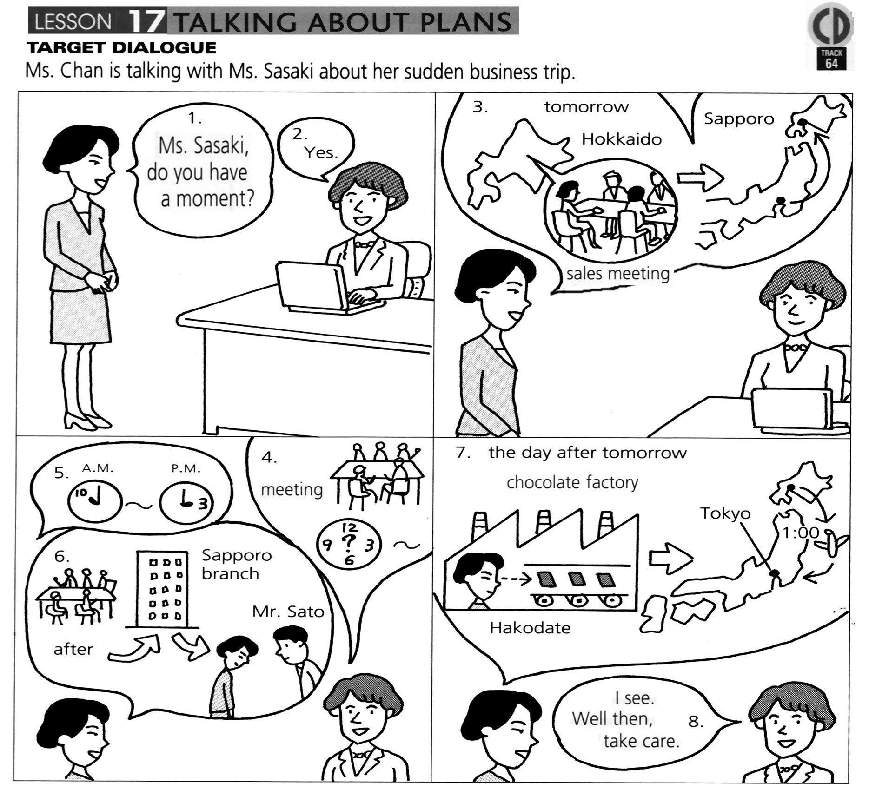


Slide 5
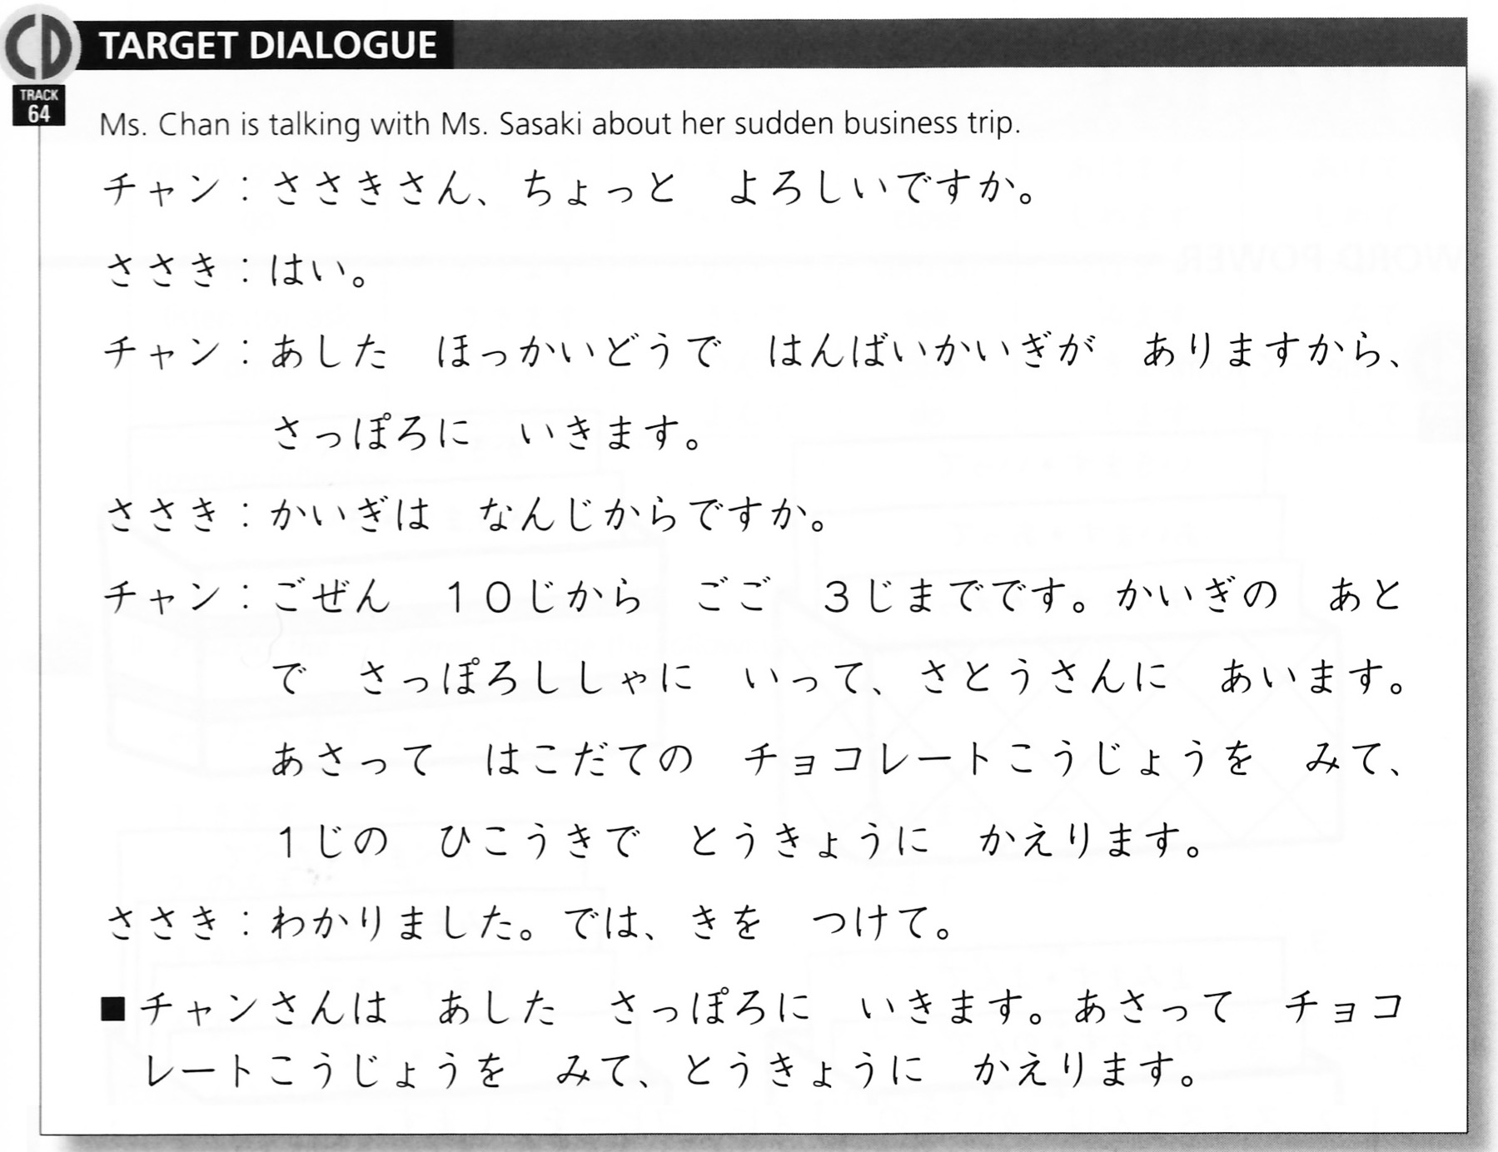
Lesson 17 Talking About Plans

Slide 6
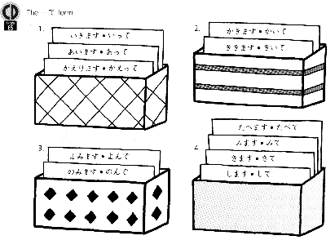
Word Power

Slide 7
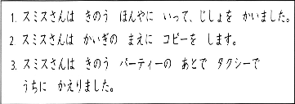
Key Sentences (日本語)

Slide 8
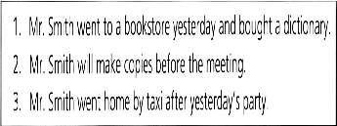
Key Sentences (英語)

Slide 9
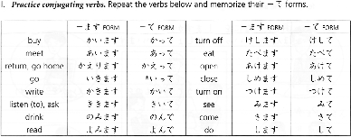
Exercise I

Slide 10
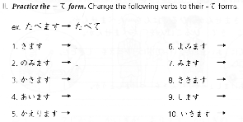
Exercise II

Slide 11
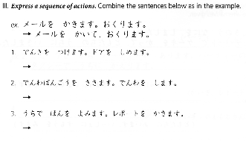
Exercise III

Slide 12
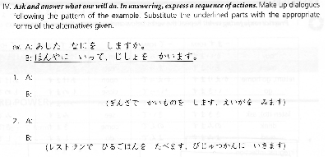
Exercise IV

Slide 13
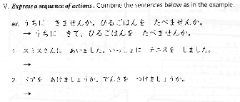
Exercise V

Slide 14
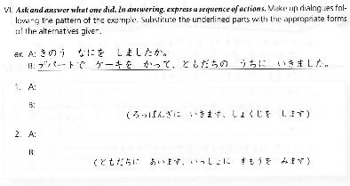
Exercise VI

Slide 15
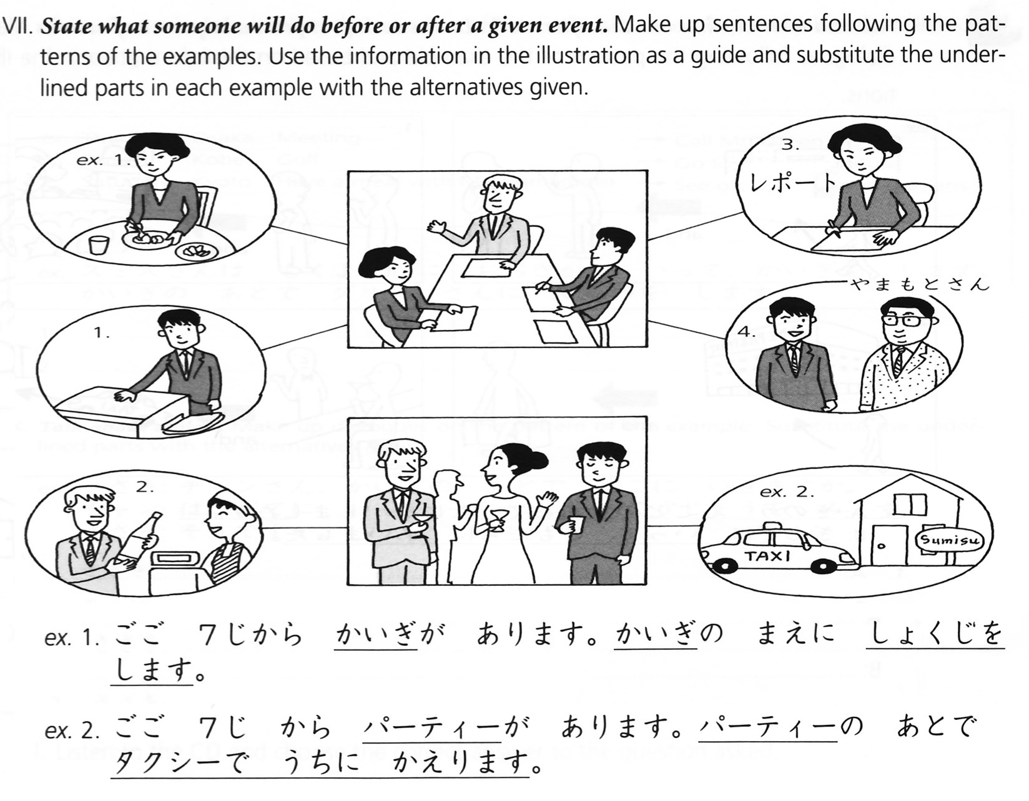
Exercise VII

Slide 16
Exercise VIII

Slide 17
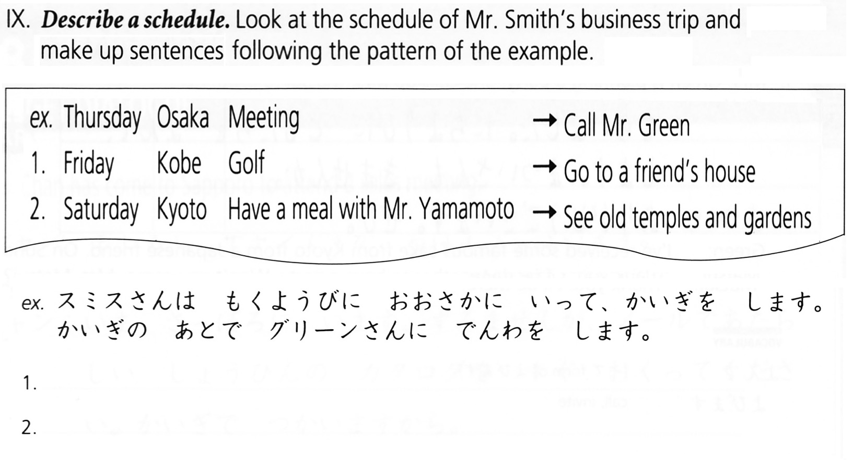
Exercise IX

Slide 18
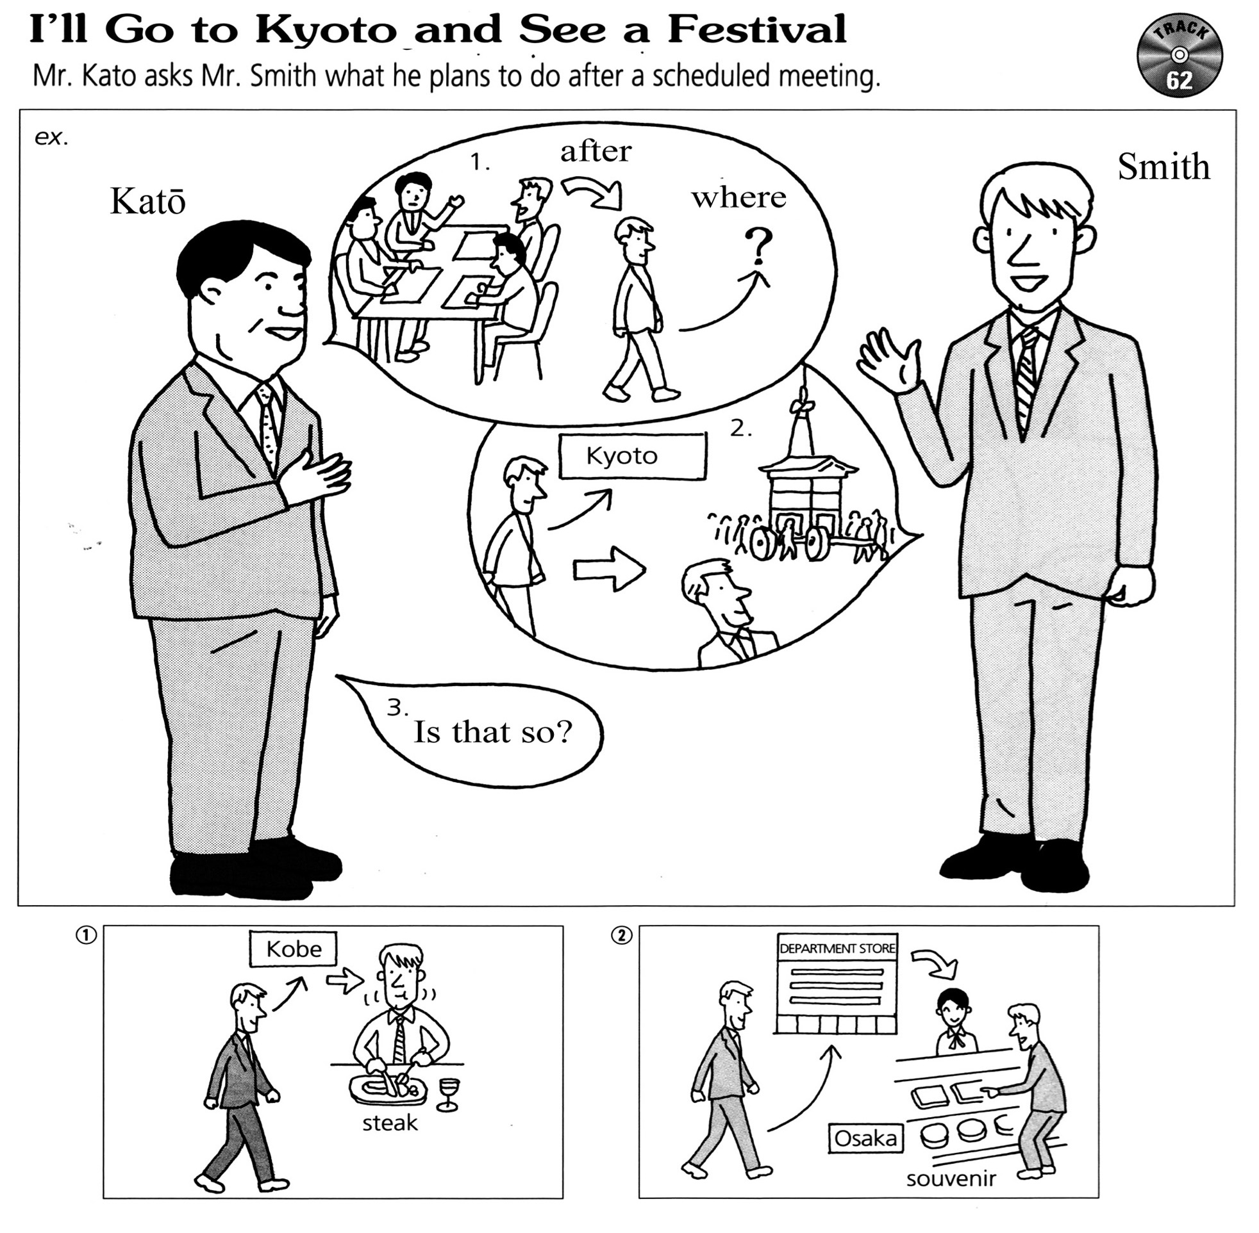
Exercise X

Slide 19
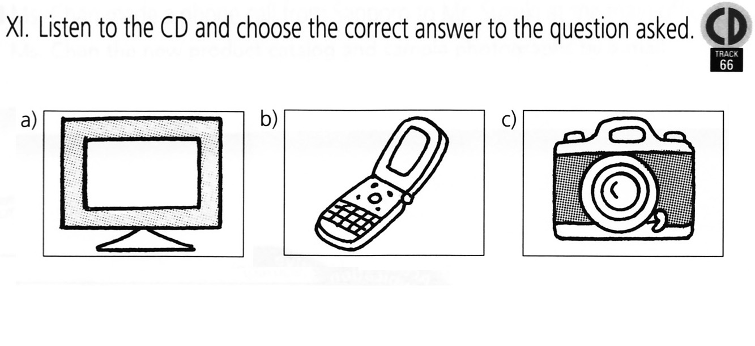
Exercise XI

Slide 20
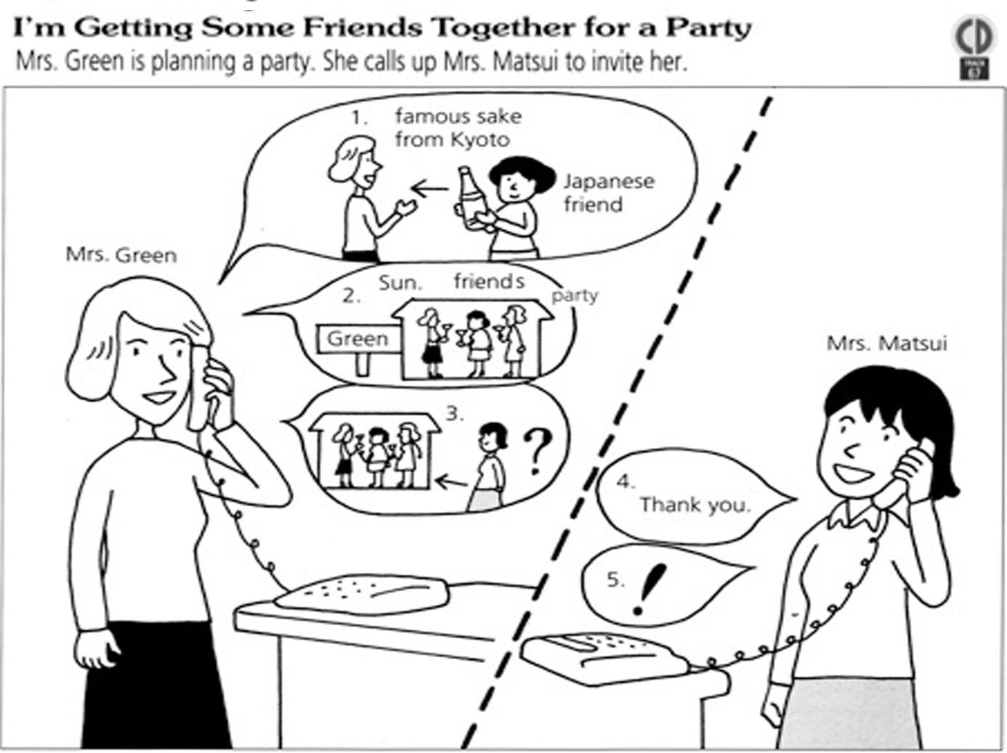
Short Dialogue I.

Slide 21
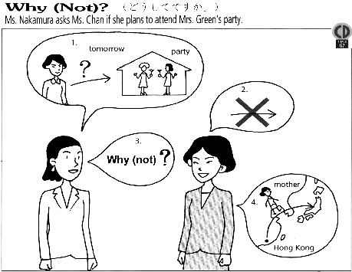
Short Dialogue II.

Slide 22
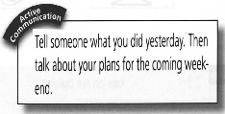
Active communication

