Slide 1

Unit 8 L17 & 18 (JFBP I)

Slide 2
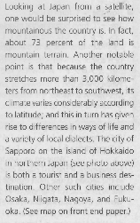

Slide 3
だい18 か Lesson 18 (JFBP I)
MAKING A REQUEST

Slide 4
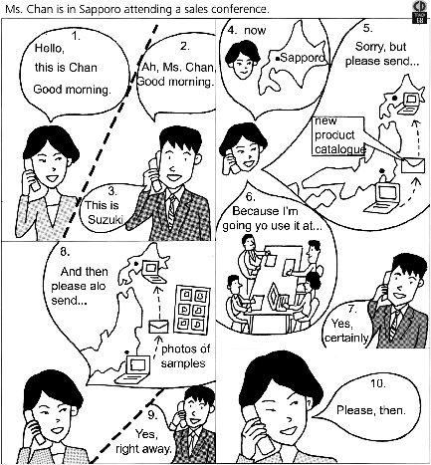
Target
Dialogue

Slide 5
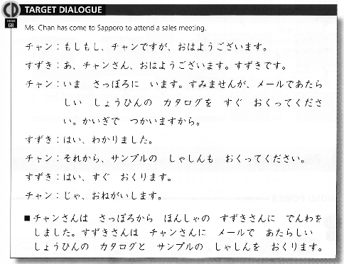
Target Dialogue

Slide 6
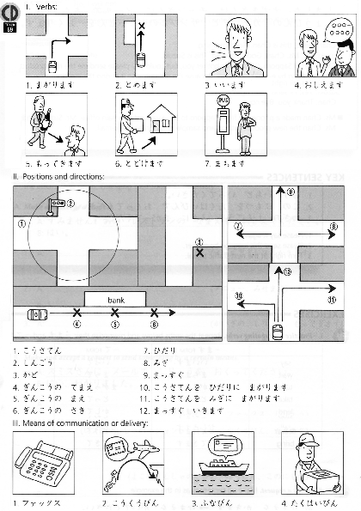
Word
Power

Slide 7
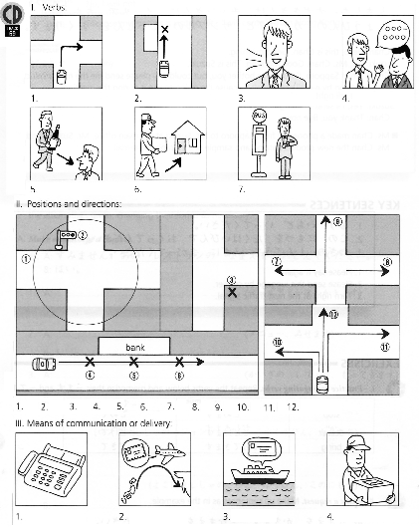
Word
Power

Slide 8
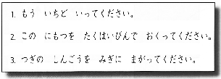
Key Sentences

Slide 9
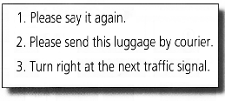
Key Sentences

Slide 10
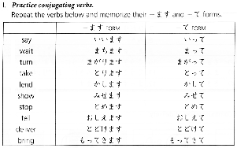
EXERCISE I

Slide 11
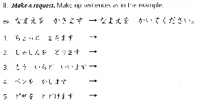
EXERCISE II

Slide 12
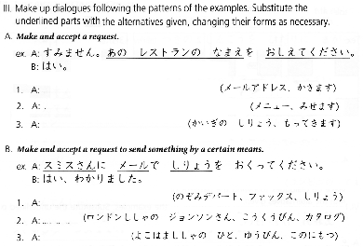
EXERCISE III

Slide 13
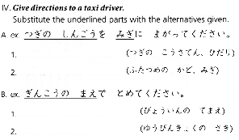
EXERCISE IV

Slide 14
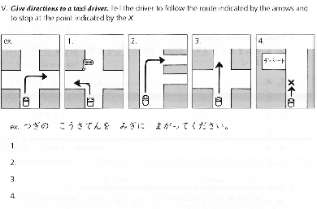
EXERCISE V

Slide 15
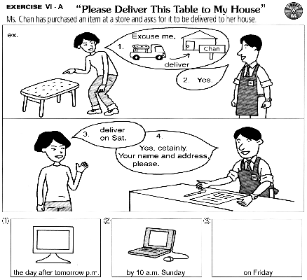
Exercise
VI (A)

Slide 16
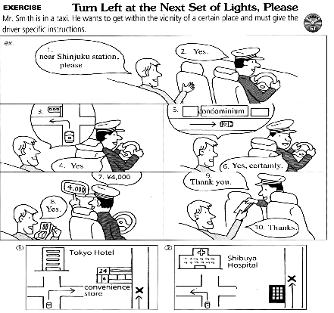
Exercise
VI (B)

Slide 17

Exercise VII (Listening)
Listening

Slide 18

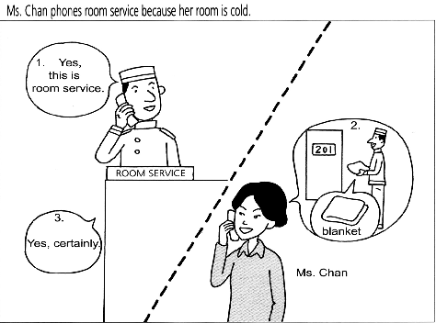

Slide 19
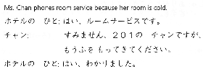

Slide 20
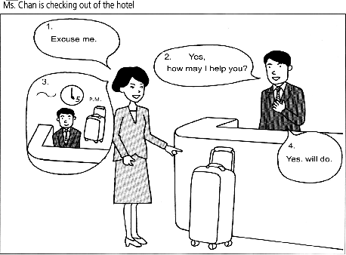

Slide 21
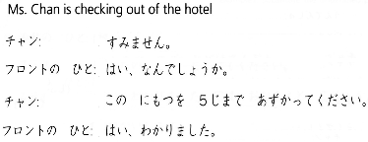

Slide 22
